Slide 1



ECE083:WORKSHOP ON ARDUINO PROGRAMMING
EM202
MOTION DETECTOR

Slide 2

INTODUCTION
Alarm based human motion detection is an embedded system which we are used to provide security. This is our proposed system. Instead of manual security if we use alarm based detection system for detecting human motions to provide security which reduces man power and is very cheap. As we know human body radiates heat in the form of Infrared radiations. When a person moving around this circuit, PIR sensor detects the change in the IR levels of surroundings and sends a signal to the microcontroller.
Motion detection using a PIR sensor circuit can be used for providing security to home, shopping malls etc, as the PIR sensor used in this system detects the motion of human around this circuit. With the help of buzzer, we can identify the motion of human which was detected by the sensor. This system can be used at any place where security is needed. Security is needed by everyone in the society now-a-days to protect their property or confidential information from others which is sensor sense a human motion and then transmit the signal wirelessly.

Slide 3
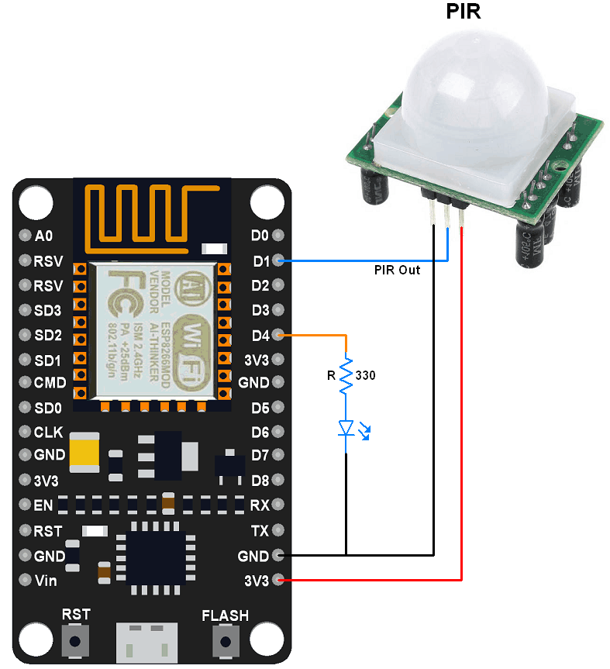
COMPONENTS USED -
NODE MCU
PIR SENSOR
BUZZER
BREADBOARD
LED
JUMPER WIRES
ADAPTER
ARDUINO IDE

Slide 4
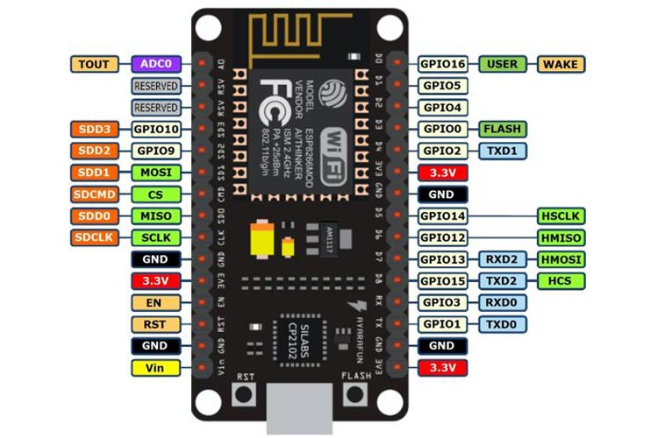
NODEMCU
NodeMCU is an open-source LUA based firmware developed for the ESP8266 wifi-chip. By exploring functionality with the ESP8266 chip, NodeMCU firmware comes with the ESP8266 Development board/kit i.e. NodeMCU Development board.
There is Version2 (V2) available for NodeMCU Dev Kit i.e. NodeMCU Development Board v1.0 (Version2), which usually comes in black colored PCB.
There are 8 digital pins and here all pins support PWM and only one analog pin is supported by NodeMCU.

Slide 5
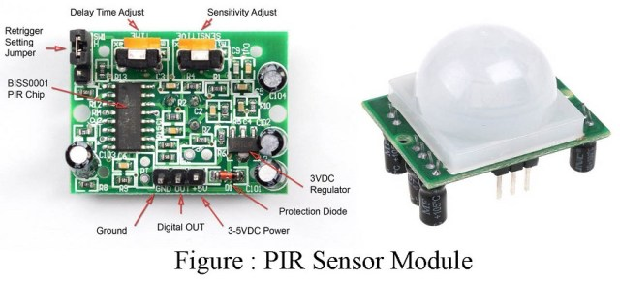
PIR SENSOR
Passive Infrared Sensor (PIR sensor) or PIR motion sensor is the kind of IR sensor that measures the Infrared radiations released from objects and thus identify them as moving or still objects. This type of motion sensor is only the receptor of infrared waves and does not release any infrared beam like that is done in Active Infrared sensors.

Slide 6
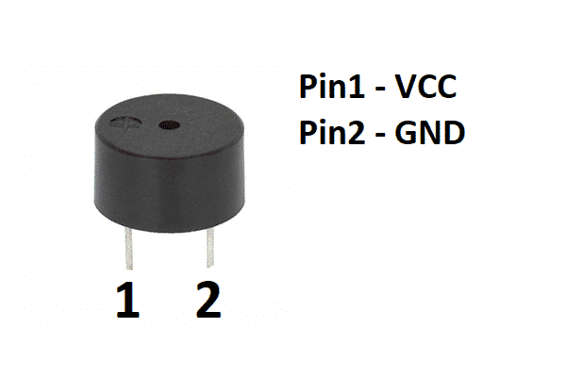
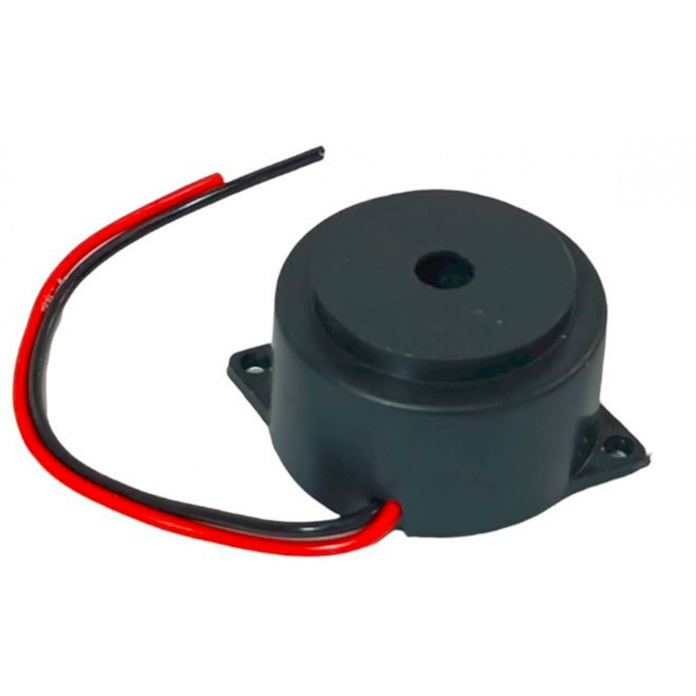
BUZZER
An audio signaling device like a beeper or buzzer may be electromechanical or piezoelectric or mechanical type. The main function of this is to convert the signal from audio to sound. Generally, it is powered through DC voltage and used in timers, alarm devices, printers, alarms, computers, etc. Based on the various designs, it can generate different sounds like alarm, music, bell & siren.

Slide 7
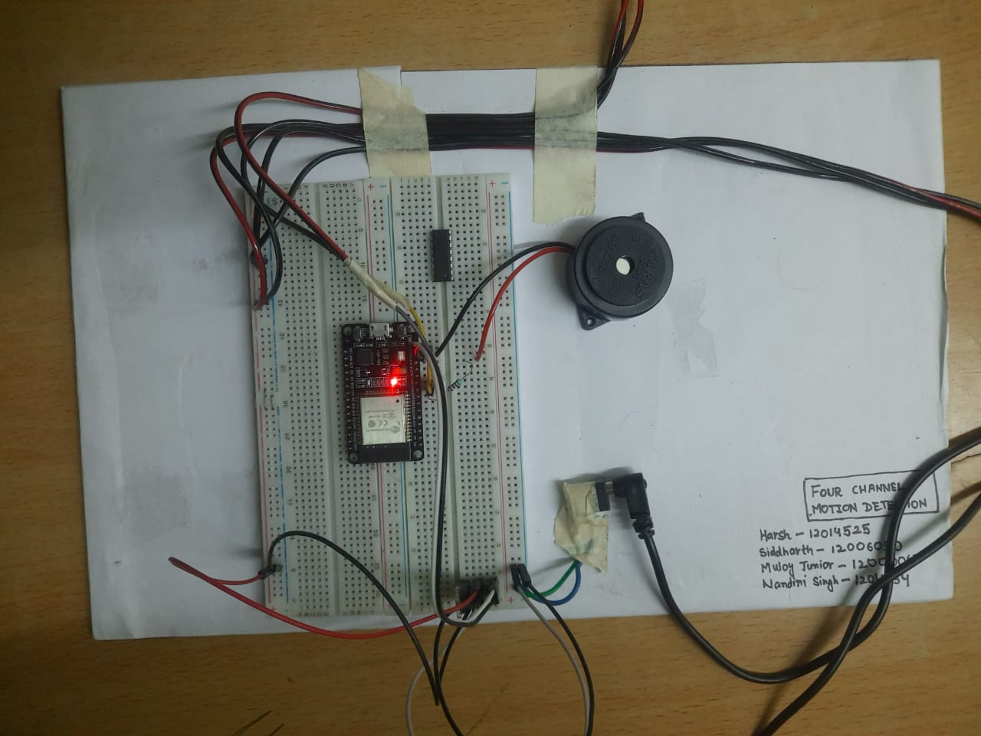
Our Project

Slide 8
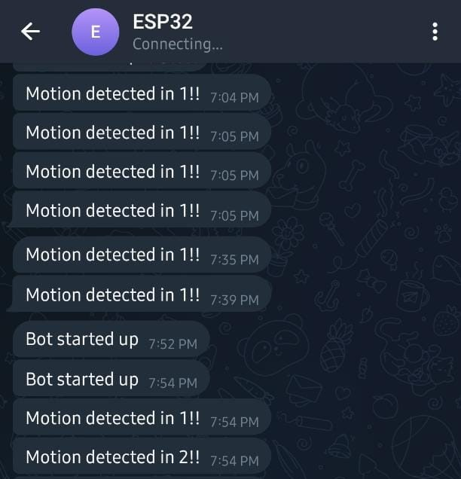
notification

Slide 9
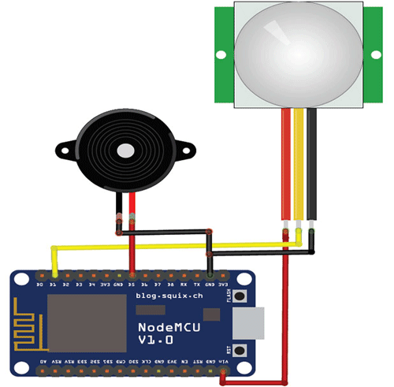
CONCLUSION-
Hereby we come to an end of or project “MOTION DETECTOR USING PIR SENSOR”. This project gives us an idea to detect the motion.
This project can be used anywhere either at home or offices. This is also cost efficient. Thus by this attempt of ours circuit can be used as protecting device and can be used for security also.
It can be used as a kind of antitheft device. It is very much cost efficient and can be used easily and efficiently.

